Slide 1

Enhancing Electric Vehicle Routing Efficiency Through K-Means Clustering and Genetic Algorithm Optimization
Capstone Project Phase A – 61998
24-1-R-20
Supervisor: Miri Weiss-Cohen
Team members: Yovel Gabay, Tal Gaon

Slide 2



Motivation
Introduction
Background
Propose solution
Product
Expansion of the EV market due to environmental and economic benefits.
Unique Challenges of Electric Vehicles: Limited Range and Charging Constraints

Slide 3
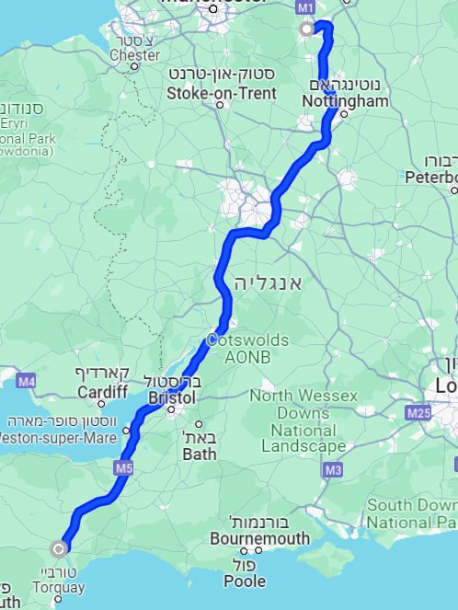

The problem
Introduction
Background
Propose solution
Product
Given a start point A and destination point B, we will ensure the EV can complete the journey within its battery charge limits while dynamically optimizing the most efficient route.
Find the most efficient route based on:
Closest charging station
The queuing times at charging stations
Abb Charging Station
EVgo Charging Station
Blink
Charging Station

Slide 4
Project Objectives
Introduction
Background
Propose solution
Product
Leveraging Established EVRP Research
Incorporating Practical Constraints:
Battery Capacity
Charging Station Locations
Queue Times
Developing an Achievable Solution:
Utilizing Existing Clustering Techniques and Genetic Algorithms

Slide 5
Background
Introduction
Background
Propose solution
Product

Slide 6

Clustering
Introduction
Background
Propose solution
Product
Unsupervised learning technique.
Goal - group similar data points and separate dissimilar ones.
It helps identify patterns and structures within datasets.

Slide 7
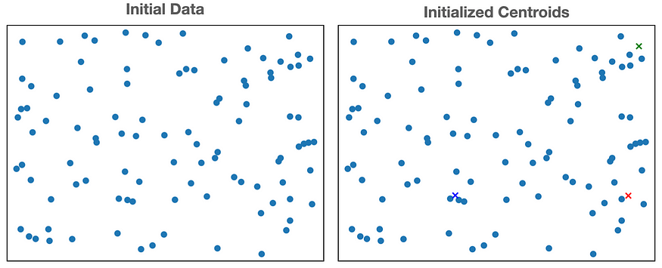
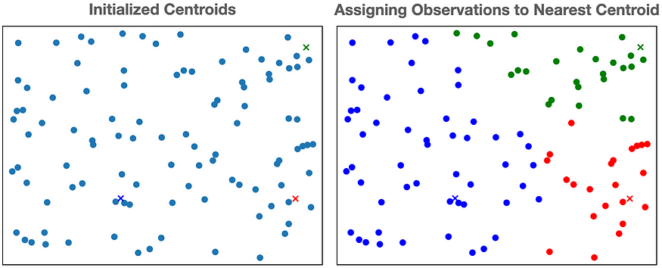
K-Means Algorithm
Introduction
Background
Propose solution
Product
Initializing a set of cluster centroids
Assigning observations to clusters
Updating the clusters
Popular clustering technique used to partition data into distinct groups based on similarity

Slide 8
Genetic Algorithm
Introduction
Background
Propose solution
Product
Genetic Algorithms (GA) are optimization techniques inspired by the process of natural selection and genetics.
Parent #1
Parent #2
Parent #3
1st generation
1 | 1 | 1 | 0 | 0
0 | 0 | 0 | 1 | 1
1 | 0 | 1 | 0 | 1
0 | 1 | 0 | 1 | 0
0 | 1 | 0 | 1 | 1
1 | 1 | 1 | 1 | 1
... #N
Fitness score:8.1
Fitness score:3.5
Fitness score:5.9
crossover
2nd generation
(before mutate)
Offspring #1
Offspring #2
1 | 1 | 1 | 0 | 0
1 | 1 | 1 | 1 | 1
0 | 1 | 0 | 1 | 1
0 | 0 | 0 | 1 | 1
... #N
mutation
2nd generation
(after mutate)
Offspring #1
Offspring #2
1 | 1 | 1 | 0 | 0
1 | 1 | 1 | 1 | 1
0 | 1 | 0 | 0 | 1
0 | 0 | 0 | 1 | 1
... #N
Fitness score:9.3
Fitness score:6.2

Slide 9
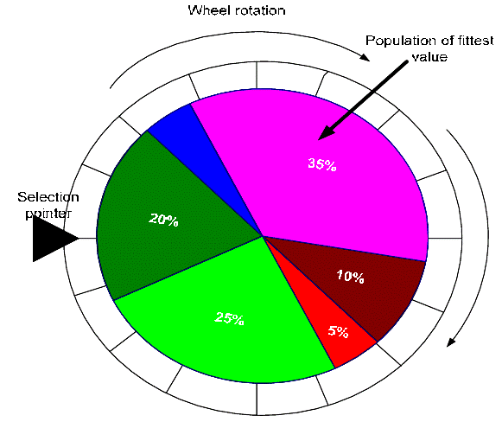
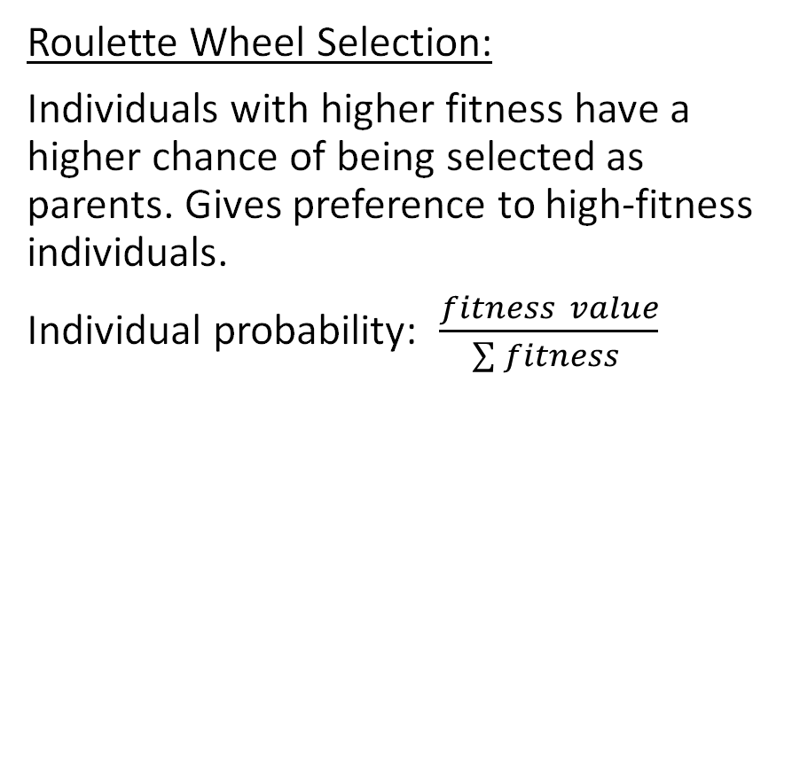
Offspring generation
Introduction
Background
Propose solution
Product
Binary Tournament Selection:
Two individuals are randomly selected, and the one with the highest fitness becomes the first parent. The second parent is selected similarly.
Ensures population diversity
Crossover Randomly selecting a division point
Roulette Wheel Selection:
Individuals with higher fitness have a higher chance of being selected as parents. Gives preference to high-fitness individuals.
Individual probability: $\frac{fitness value}{\sum{fitness} }$
Parents
1 | 0 | 1 | 0 | 1 | 0 | 0
0 | 1 | 0 | 1 | 0 | 1 | 1
Offspring
1 | 0 | 0 | 1 | 0 | 1 | 1
0 | 1 | 1 | 0 | 1 | 0 | 0

Slide 10
Propose solution
Introduction
Background
Propose solution
Product

Slide 11
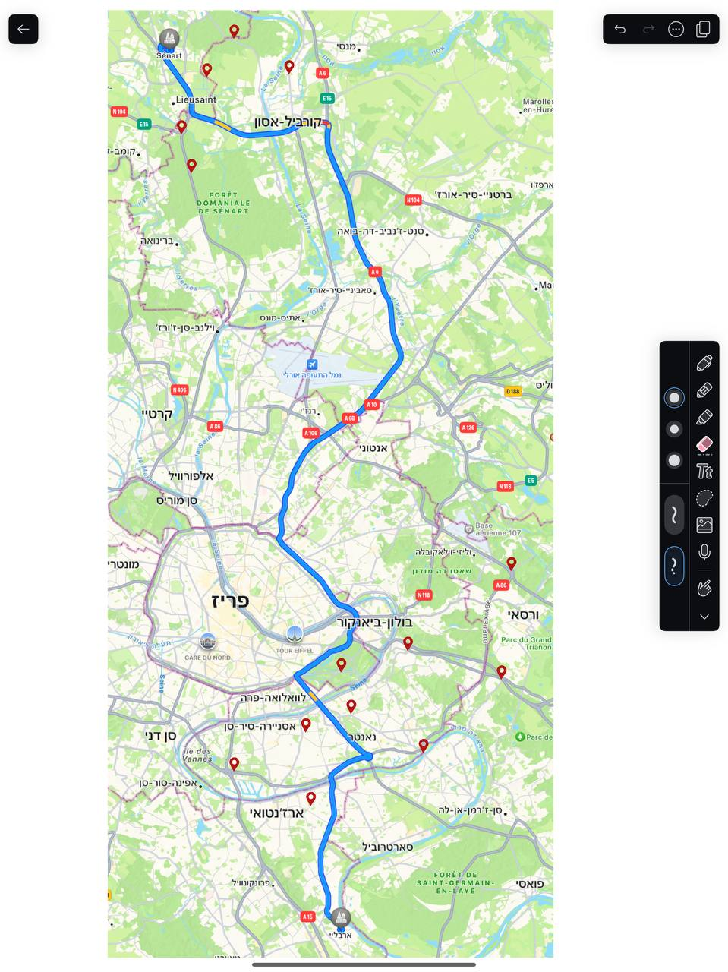
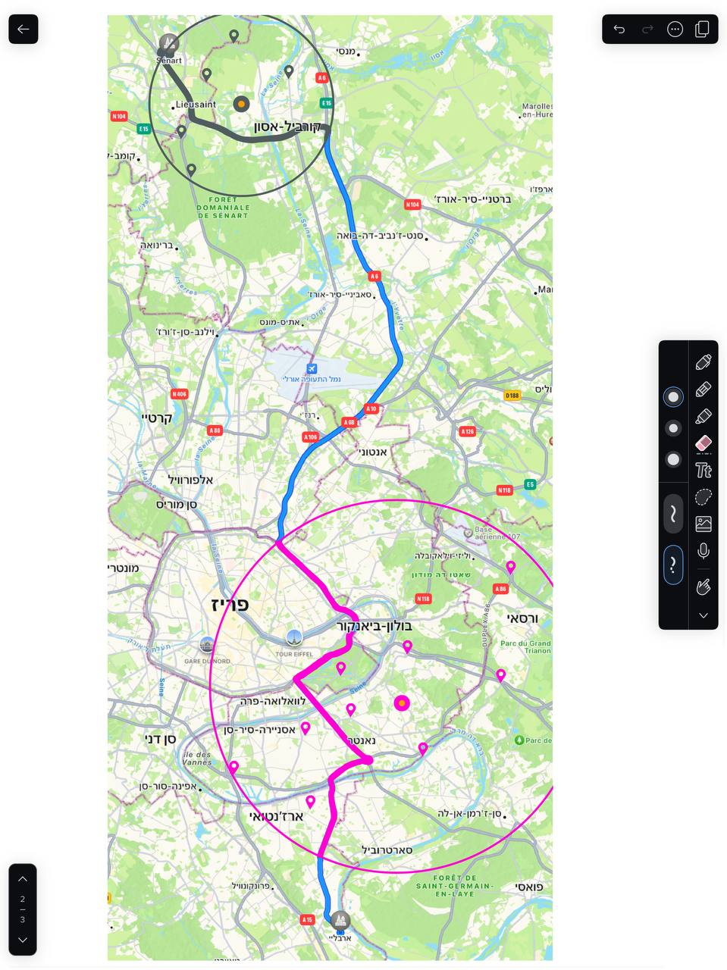
Propose solution
Introduction
Background
Propose solution
Product
Clusters of nearby charging stations
Our approach involves two phases:
Partitioning Charging Stations into Clusters based on their geographical proximity.
Optimizing the Total Travel Distance using a Genetic Algorithm
Clustering

Slide 12
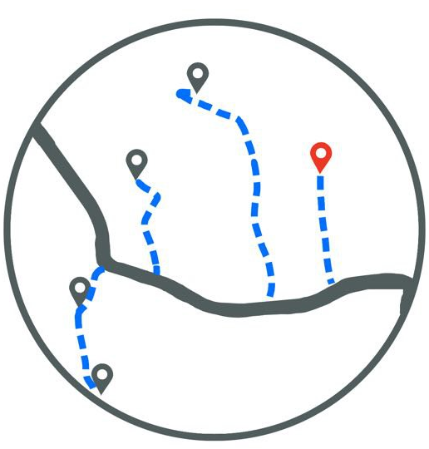
Propose solution
Introduction
Background
Propose solution
Product
In each cluster known waiting times for its stations
The optimizing process involves dynamically reassessing the route.
2m
4m
3.2km
9m
1.6km
1.5km
8m
1km
2.1km
4m

Slide 13
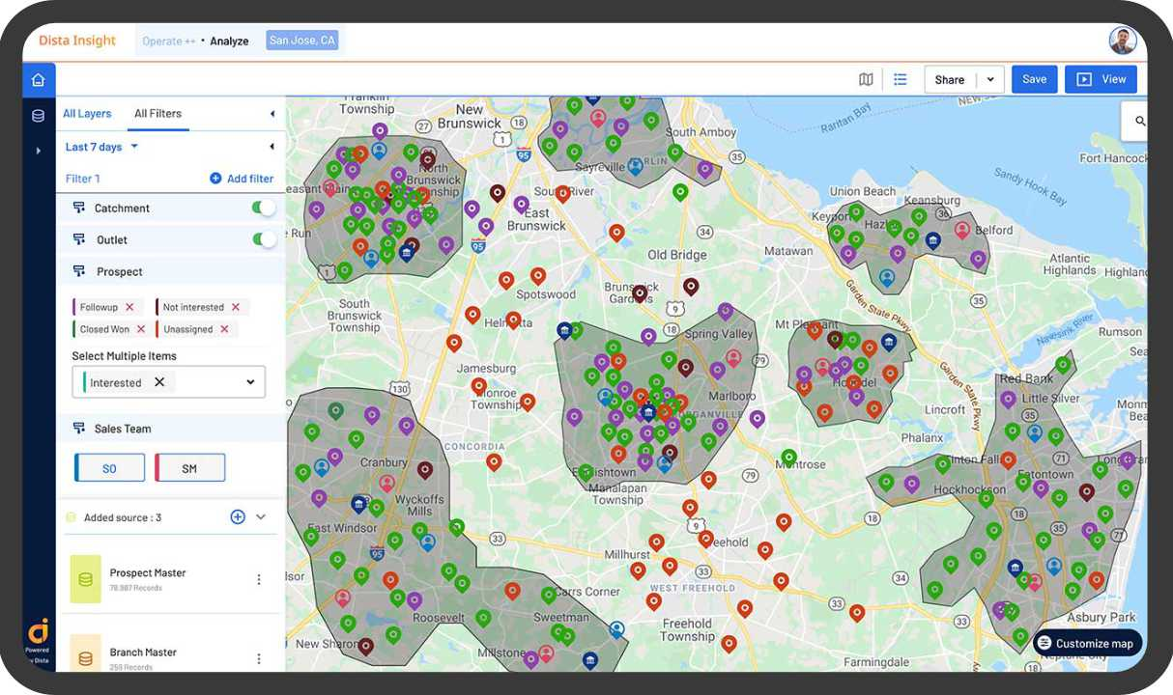


1. Clustering
Introduction
Background
Propose solution
Product
We employ K-Means clustering to efficiently group charging stations.
The goal
Considering only the charging stations in the cluster itself
Reduces the search space and the number of potential charging stations that the algorithm needs to evaluate
Enables the algorithm to handle larger problem instances more efficiently

Slide 14
2. Genetic algorithm
Introduction
Background
Propose solution
Product
Challenges
Analyze and carefully select genetic operators
Precisely define the fitness function to evaluate solutions and determine the optimal solution
Initial Population
Fitness Evaluation
Parent Selection
Crossover function
Mutation function
Continue?
stop

Slide 15
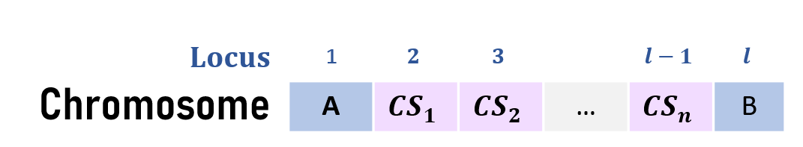
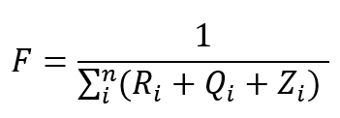
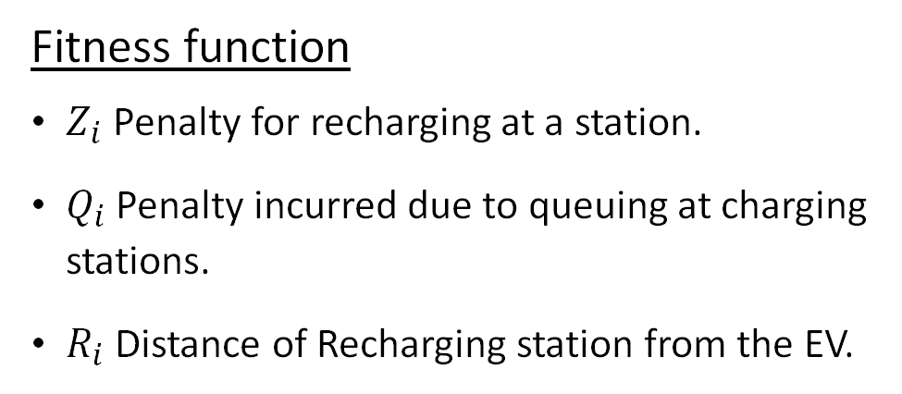
2. Genetic algorithm
Introduction
Background
Propose solution
Product
Proposed solution
Chromosome
Represents a routing path for an EV with stops at charging stations.
Unfixed length -reflecting different numbers of stops required.
Fitness function
$Z_{i}$ Penalty for recharging at a station.
$Q_{i}$ Penalty incurred due to queuing at charging stations.
$R_{i}$ Distance of Recharging station from the EV.

Slide 16
Product
Introduction
Background
Propose solution
Product

Slide 17

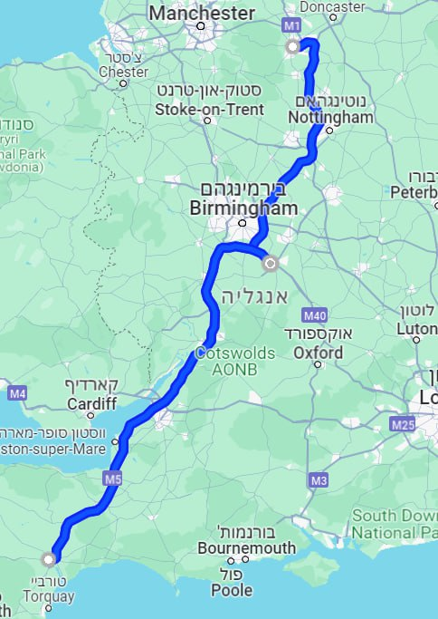





Introduction
Background
Propose solution
Product
Enjoy your ride!
Sheffield, UK Exeter, UK
Sheffield, UK
100%
EVgo Charging Station
146 km
EVgo charging station
275 km
Exeter, UK
26%
Remaining distance
421 km

Slide 18
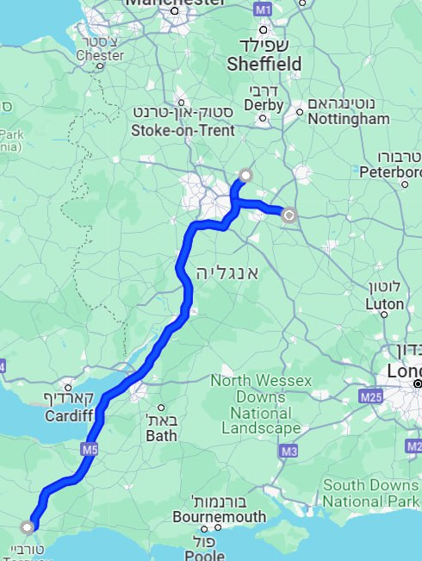
Introduction
Background
Propose solution
Product
The route has been updated!
Sheffield, UK Exeter, UK
Your current location
82%
Abb Charging Station
77 km
Abb charging station
290 km
Exeter, UK
24%
Remaining distance
321 km

Slide 19
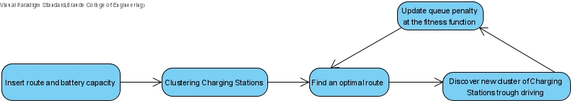
Flow chart
Introduction
Background
Propose solution
Product
Emphasize the dynamic process

Slide 20
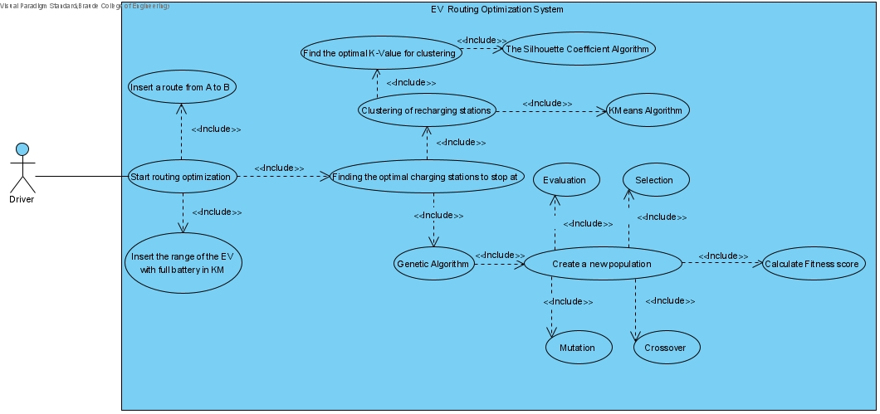
Use Case diagram
Introduction
Background
Propose solution
Product

Slide 21
Contribution of our solution
Introduction
Background
Propose solution
Product
Grouping Charging Stations:
Search Space Reduction
Efficiency Improvement
Incorporating Real-World Scenarios: Waiting times at charging stations.
Dynamic Adaptation: The algorithm dynamically adapts to real-time data- changes in waiting times at charging stations.

Slide 22
Verification plan
Introduction
Background
Propose solution
Product
 | Test Case | Expected Result
Input Validation | Insert invalid start or destination points (e.g., non-existent locations or invalid format). | Error message: "Invalid start/destination point."
 | Enter a negative or zero value for battery charge capacity. | Error message: "Invalid battery charge capacity."
 | The user doesn’t insert value for start or destination points. | The "OK“ button is disabled.
 | The user doesn’t insert a value for battery charge capacity. | The "OK" button is disabled.
 | Impossible route (e.g., there are not enough charging stations to complete the route). | Output: "Unable to complete the route due to insufficient charging stations. Please select a different route or adjust the battery charge capacity."
User interaction | Click on the “CANCEL” button. | Empty the fields.
 | Click the "OK" button. The start and destination points are valid, and it is a possible route. | Display the ‘Route Information’ screen.
 | Click the “Optimize my route” button. | Display the ‘Output’ screen, which shows the route's stages, the charging stations, and their waiting times.

Slide 23
Expected achievements
Introduction
Background
Propose solution
Product
Optimal Route:
Minimize travel distance, charging stops, and waiting times.
Robust Framework:
Provide a practical and efficient solution for EV drivers that's adaptable to various scenarios in real-time.
Flexible Software System:
Scalable to handle varying numbers and wide distribution of charging stations.

Slide 24
Thank you!

